Slide 1
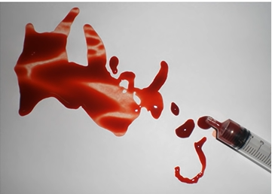
U n i v e r s i t y o f b a s r a h
Al - z a h r a a m e d i c a l c o l l e g e
Ministry of higher Education and Scientific Research
Foundation of Medicine
Semester : 1
lecture : 5
Lecture title
: Medical Terminology
Blood and Lymphatic system
by
Dr. Zainab k. khaleel

Slide 2
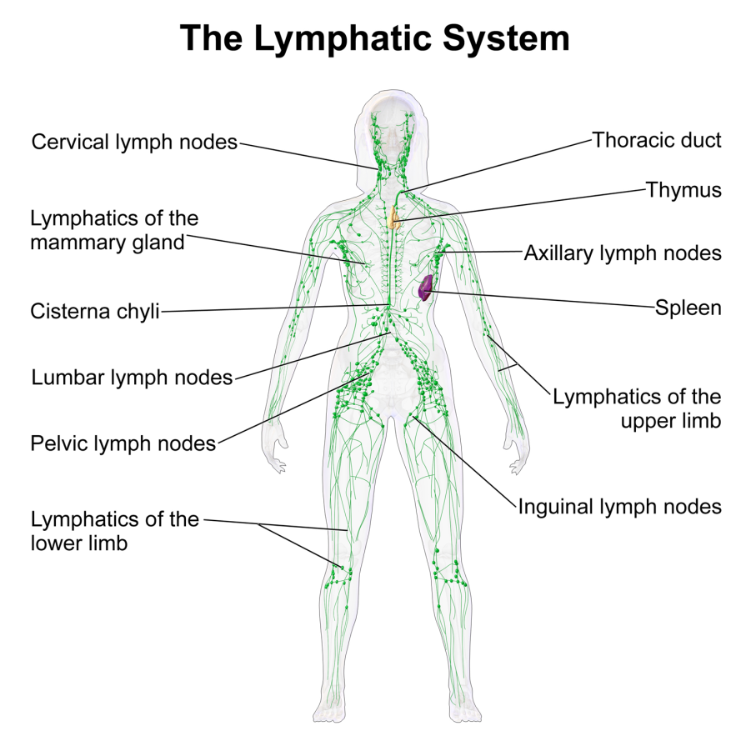
U N I V E R S I T Y O F B A S R A H
AL - Z A H R A A M E D I C A L C O L L E G E
Ministry of higher Education
and Scientific Research
The lymphatic system
Lymph
It is a colorless to white fluid that flows through the lymphatic system. It is composed of blood plasma that leaks out of the capillaries into the tissues, then reabsorbed back towards the heart for re-circulation.
The lymphatic system
Lymph
Lymphatic Vessels
Lymphatic Capillaries
Lymphatic Vessels
Lymphatic Trunks
Lymphatic Ducts
Lymphatic Organs
Thymus
Lymph Nodes
Spleen
Tonsils
Lymphatic cells

Slide 3
U N I V E R S I T Y O F B A S R A H
AL - Z A H R A A M E D I C A L C O L L E G E
Ministry of higher Education and Scientific Research
Functions of the Lymphatic System
Reabsorbs excess interstitial fluid:
Returns it to the venous circulation
Maintain blood volume levels
Prevent interstitial fluid levels from rising out of control.
Transport dietary lipids:
Transported through lacteals
Drain into larger lymphatic vessels
Eventually into the bloodstream.
Lymphocyte development, and the immune response.

Slide 4
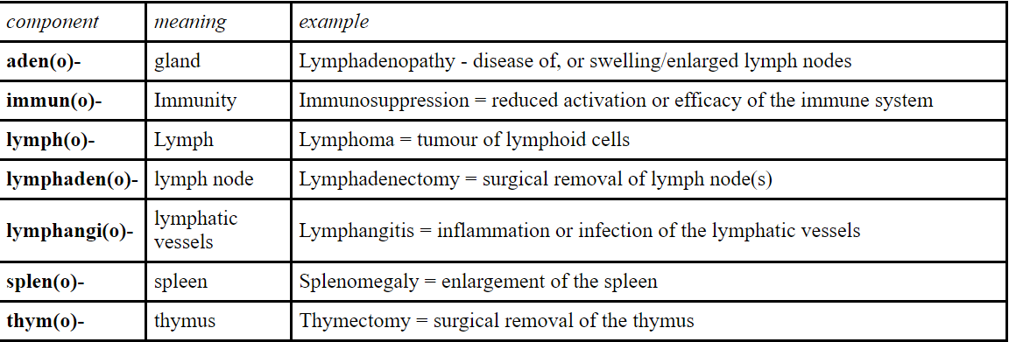
U N I V E R S I T Y O F B A S R A H
AL - Z A H R A A M E D I C A L C O L L E G E
Ministry of higher Education and Scientific Research
Some medical terms related to the Lymphatic and Immune systems

Slide 5
U N I V E R S I T Y O F B A S R A H
AL - Z A H R A A M E D I C A L C O L L E G E
Ministry of higher Education and Scientific Research
Medical prefixes for the blood and lymph.sys.
prefix | Definition
An- | Without or absence
Anti- | Against or opposite
Mal- | Bad
Mono- | One
Trans- | Across
Macro | Large
Micro | Small

Slide 6
U N I V E R S I T Y O F B A S R A H
AL - Z A H R A A M E D I C A L C O L L E G E
Ministry of higher Education and Scientific Research
Medical suffixes for the blood & lymph.sys.
Suffix | Definition
-lysis | Destruction/ breaking down
-penia | Abnormal reduction in number or deficiency
-ia | Condition of
-ic | Pertaining to
-ology | Study or science of

Slide 7
U n i v e r s i t y o f b a s r a h
al - z a h r a a m e d i c a l c o l l e g e
Ministry of higher Education and Scientific Research
Suffix | Definition
-oma | Tumor
-osis | Condition of
-pathy | Disease
-philia | Loving, love of, or affinity for
-rrhage | Profuse bleeding, hemorrhage
- crit | Separate
- stat | stop

Slide 8
U N I V E R S I T Y O F B A S R A H
AL - Z A H R A A M E D I C A L C O L L E G E
Ministry of higher Education and Scientific Research
Root word | Definition
Hem or hemat | Blood
leuk | White
Lymph | Clear water or fluid
Necr | Death
Nucle | Nucleus
Phylaxis | Protection
Sept | wall
Thromb | Clot
Tox | Poison

Slide 9
U N I V E R S I T Y O F B A S R A H
AL - Z A H R A A M E D I C A L C O L L E G E
Ministry of higher Education and Scientific Research
Hematology
The general field of medicine focusing on
blood-related disease.
A physician specializing in blood diseases is called a hematologist.
Haem (o) /(hem)/ hemato
means blood

Slide 10
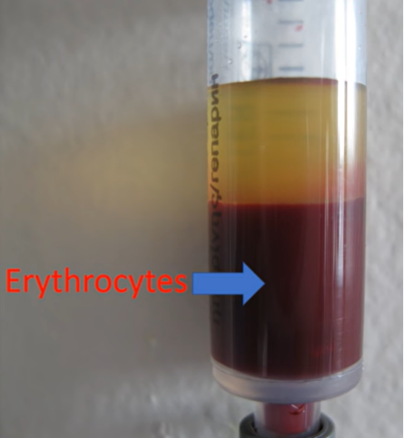
U N I V E R S I T Y O F B A S R A H
AL - Z A H R A A M E D I C A L C O L L E G E
Ministry of higher Education and Scientific Research
Medical root words of the blood and lymphatic sys.
Root meaning
Globin protein in blood
Immun immunity
Lymph Clear water or fluid
Erythro red
Erythrocytes red blood cells
Erythrocytosis ?
Erythropenia ?

Slide 11
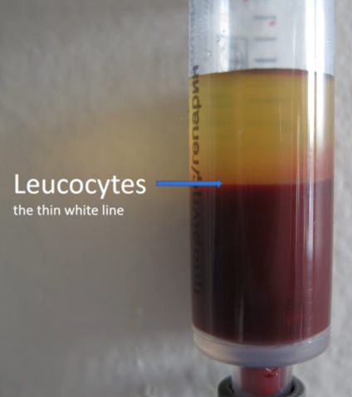
U N I V E R S I T Y O F B A S R A H
AL - Z A H R A A M E D I C A L C O L L E G E
Ministry of higher Education and Scientific Research
Medical root words of the blood and lymphatic sys.
Root meaning
Leuco /leuk(o) white
Leucocytes white blood cells
Leucocytosis ??
Leucopenia ? ?
leukemia ? ? ?

Slide 12
U N I V E R S I T Y O F B A S R A H
AL - Z A H R A A M E D I C A L C O L L E G E
Ministry of higher Education and Scientific Research
Medical root words of the blood and lymphatic sys.
Erythrocytosis | Leucocytosis
Abnormally increased number of red blood cells in a blood sample. | Abnormally increased number of white blood cells in a blood sample.

Slide 13
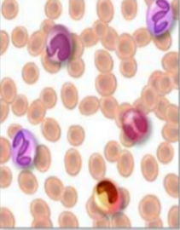
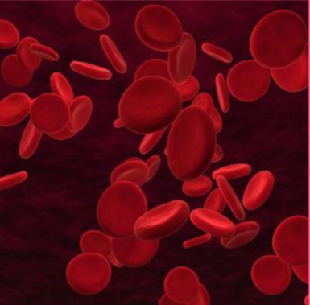
U N I V E R S I T Y O F B A S R A H
AL - Z A H R A A M E D I C A L C O L L E G E
Ministry of higher Education and Scientific Research
Medical root words of the blood and lymphatic sys.
Erythropenia | Leukopenia
Abnormally reduced number of red blood cells in a blood sample. | Abnormally reduced number of white blood cells in a blood sample.

Slide 14
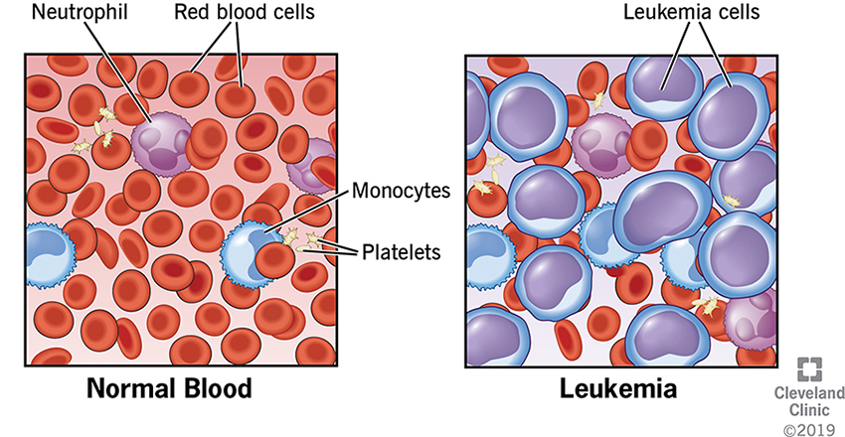
U N I V E R S I T Y O F B A S R A H
AL - Z A H R A A M E D I C A L C O L L E G E
Ministry of higher Education and Scientific Research
Leukemia
Cancer of blood forming cells in the bone marrow and the lymphatic system. Causing the production of abnormal and excess white blood cells .

Slide 15
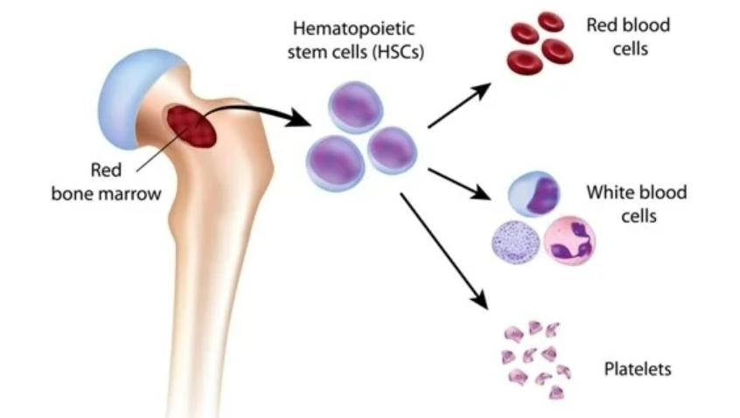
U N I V E R S I T Y O F B A S R A H
AL - Z A H R A A M E D I C A L C O L L E G E
Ministry of higher Education and Scientific Research
Hematology / Haematology
Haemopoiesis: the process of formation of blood cells (RBC, WBC and platelets) and the sites where it occurs are known as hemopoietic tissues (bone marrow, liver and spleen)

Slide 16
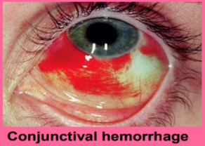
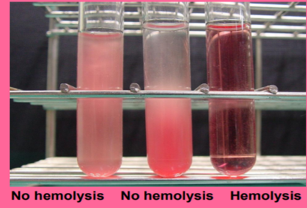
U N I V E R S I T Y O F B A S R A H
AL - Z A H R A A M E D I C A L C O L L E G E
Ministry of higher Education and Scientific Research
Diseases and disorders of the blood and lym.sys.:
Haemorrhage: abnormal loss of blood due to rupture of blood vessel as a result of injury or illness.
Haemolysis: rupture of red blood cells with the release of hemoglobin into the plasma or serum, that may occur if blood transfusion is not compatible with recipient´s blood.

Slide 17
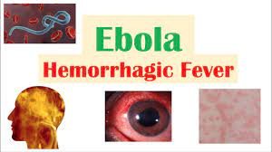
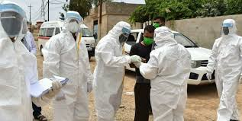
U N I V E R S I T Y O F B A S R A H
AL - Z A H R A A M E D I C A L C O L L E G E
Ministry of higher Education and Scientific Research
Diseases and disorders of the blood and lym.sys.:
Viral hemorrhagic fevers (VHFs):
Those are an infections caused by viruses include (Ebola) that often life threatening and cause fever and damage of the blood vessels and can cause severe bleeding.

Slide 18
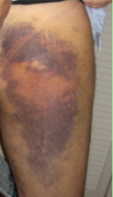
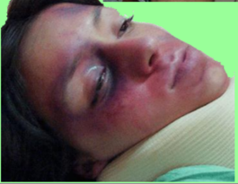
U N I V E R S I T Y O F B A S R A H
AL - Z A H R A A M E D I C A L C O L L E G E
Ministry of higher Education and Scientific Research
Diseases and disorder of blood and lym.sys.
Haematoma a localized bleeding outside of blood vessels, due to either disease or trauma.

Slide 19
U N I V E R S I T Y O F B A S R A H
AL - Z A H R A A M E D I C A L C O L L E G E
Ministry of higher Education and Scientific Research
Self learning
What is the difference between hematoma and Bruise ?

Slide 20
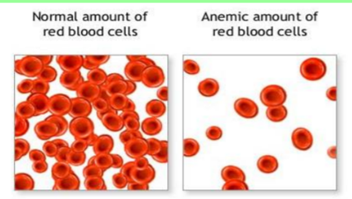
U N I V E R S I T Y O F B A S R A H
AL - Z A H R A A M E D I C A L C O L L E G E
Ministry of higher Education and Scientific Research
Diseases and disorder of blood and lymphatic system
Anemia is characterized by a reduced number of red blood cells or their ability to carry O2.
Prefix (an) mean without.
Suffix (emia) mean condition of blood.

Slide 21
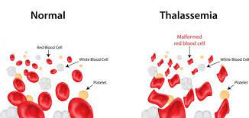
U N I V E R S I T Y O F B A S R A H
AL - Z A H R A A M E D I C A L C O L L E G E
Ministry of higher Education and Scientific Research
Diseases and disorder of blood and lymphatic system
Hypoglycemia mean low blood glucose
Hyperglycemia ?? Self learning
Thalassemia are inherited blood disorders characterized by decreased hemoglobin production

Slide 22
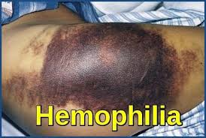
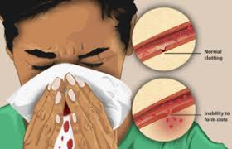
U N I V E R S I T Y O F B A S R A H
AL - Z A H R A A M E D I C A L C O L L E G E
Ministry of higher Education and Scientific Research
Diseases and disorder of blood and lymphatic system
Hemophilia
Is an inherited disorder. There is an absence of blood clotting proteins that are necessary for coagulation. Those patients may experience abnormal blood loss even after minor injuries.
Treatment:
Replacement of blood clotting factors.

Slide 23
U N I V E R S I T Y O F B A S R A H
AL - Z A H R A A M E D I C A L C O L L E G E
Ministry of higher Education and Scientific Research
Diseases and disorder of blood and lymphatic system
Dyscrasia :
It’s a term derived from the Greek word (difficult temperament ) that refers to abnormal blood condition.

Slide 24
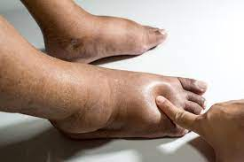
U N I V E R S I T Y O F B A S R A H
AL - Z A H R A A M E D I C A L C O L L E G E
Ministry of higher Education and Scientific Research
Diseases and disorder of blood and lymphatic system
Edema:
This is a non constructed term, derived from the Greek word oidema meaning swelling. Edema occurs when there is leaking of fluid from the bloodstream into the interstitial ( enter STISH ul) space between body cells.

Slide 25
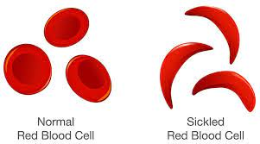
U N I V E R S I T Y O F B A S R A H
AL - Z A H R A A M E D I C A L C O L L E G E
Ministry of higher Education and Scientific Research
Diseases and disorder of blood and lymphatic system
Hemoglobinopathy:
It is a disease that affect the hemoglobin or protein within the red blood cells. Sickle cell anemia that particularly affects the African-American community, is a form of hemoglobinopathy.

Slide 26
U N I V E R S I T Y O F B A S R A H
AL - Z A H R A A M E D I C A L C O L L E G E
Ministry of higher Education and Scientific Research

Slide 27
U N I V E R S I T Y O F B A S R A H
AL - Z A H R A A M E D I C A L C O L L E G E
Ministry of higher Education and Scientific Research

Slide 28
U N I V E R S I T Y O F B A S R A H
AL - Z A H R A A M E D I C A L C O L L E G E
Ministry of higher Education and Scientific Research

Slide 29
U N I V E R S I T Y O F B A S R A H
AL - Z A H R A A M E D I C A L C O L L E G E
Ministry of higher Education and Scientific Research

Slide 30
Ministry of higher Education and Scientific Research
U N I V E R S I T Y O F B A S R A H
AL - Z A H R A A M E D I C A L C O L LE G E
Ministry of higher Education and Scientific Research
U N I V E R S I T Y O F B A S R A H
AL - Z A H R A A M E D I C A L C O L L E G E

Slide 31
Ministry of higher Education and Scientific Research
U N I V E R S I T Y O F B A S R A H
AL - Z A H R A A M E D I C A L C O L LE G E
Ministry of higher Education and Scientific Research
U N I V E R S I T Y O F B A S R A H
AL - Z A H R A A M E D I C A L C O L L E G E

Slide 32
Ministry of higher Education and Scientific Research
U N I V E R S I T Y O F B A S R A H
AL - Z A H R A A M E D I C A L C O L LE G E
Ministry of higher Education and Scientific Research
U N I V E R S I T Y O F B A S R A H
AL - Z A H R A A M E D I C A L C O L L E G E

Slide 33
Ministry of higher Education and Scientific Research
U N I V E R S I T Y O F B A S R A H
AL - Z A H R A A M E D I C A L C O L L E G E
Ministry of higher Education and Scientific Research
U N I V E R S I T Y O F B A S R A H
AL - Z A H R A A M E D I C A L C O L L E G E

Slide 34
Ministry of higher Education and Scientific Research
U N I V E R S I T Y O F B A S R A H
AL - Z A H R A A M E D I C A L C O L L E G E
Ministry of higher Education and Scientific Research
U N I V E R S I T Y O F B A S R A H
AL - Z A H R A A M E D I C A L C O L L E G E

Slide 35
Ministry of higher Education and Scientific Research
U N I V E R S I T Y O F B A S R A H
AL - Z A H R A A M E D I C A L C O L L E G E
Ministry of higher Education and Scientific Research
U N I V E R S I T Y O F B A S R A H
AL - Z A H R A A M E D I C A L C O L L E G E

Slide 36
Ministry of higher Education and Scientific Research
U N I V E R S I T Y O F B A S R A H
AL - Z A H R A A M E D I C A L C O L L E G E
Ministry of higher Education and Scientific Research
U N I V E R S I T Y O F B A S R A H
AL - Z A H R A A M E D I C A L C O L L E G E

Slide 37
Ministry of higher Education and Scientific Research
U N I V E R S I T Y O F B A S R A H
AL - Z A H R A A M E D I C A L C O L L E G E
Ministry of higher Education and Scientific Research
U N I V E R S I T Y O F B A S R A H
AL - Z A H R A A M E D I C A L C O L L E G E

Slide 38
Ministry of higher Education and Scientific Research
U N I V E R S I T Y O F B A S R A H
AL - Z A H R A A M E D I C A L C O L L E G E
Ministry of higher Education and Scientific Research
U N I V E R S I T Y O F B A S R A H
AL - Z A H R A A M E D I C A L C O L L E G E

Slide 39
Ministry of higher Education and Scientific Research
U N I V E R S I T Y O F B A S R A H
AL - Z A H R A A M E D I C A L C O L L E G E
Ministry of higher Education and Scientific Research
U N I V E R S I T Y O F B A S R A H
AL - Z A H R A A M E D I C A L C O L L E G E

Slide 40
Ministry of higher Education and Scientific Research
U N I V E R S I T Y O F B A S R A H
AL - Z A H R A A M E D I C A L C O L L E G E
Ministry of higher Education and Scientific Research
U N I V E R S I T Y O F B A S R A H
AL - Z A H R A A M E D I C A L C O L L E G E

Slide 41
Ministry of higher Education and Scientific Research
U N I V E R S I T Y O F B A S R A H
AL - Z A H R A A M E D I C A L C O L L E G E
Ministry of higher Education and Scientific Research
U N I V E R S I T Y O F B A S R A H
AL - Z A H R A A M E D I C A L C O L L E G E

Slide 42
Ministry of higher Education and Scientific Research
U N I V E R S I T Y O F B A S R A H
AL - Z A H R A A M E D I C A L C O L L E G E
Ministry of higher Education and Scientific Research
U N I V E R S I T Y O F B A S R A H
AL - Z A H R A A M E D I C A L C O L L E G E

